Slide 1
Arduino
FeMaidens Programming 2017-2018

Slide 2
What is an Arduino?

Slide 3
It is a microcontroller that receives inputs and drives outputs easily.
Notes:
Microcontroller =small computer on a single integrated circuit (system on a chip)
Inputs include sensors; outputs include screen/monitor, light
Purpose: LED

Slide 4
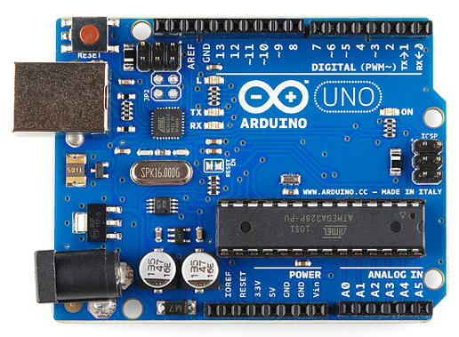
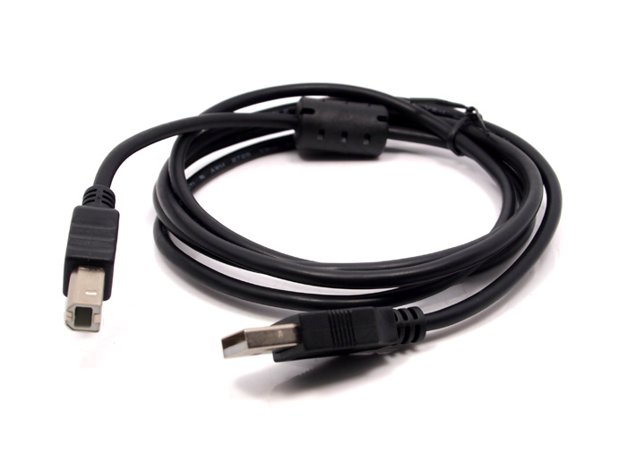
Important components of the arduino:
•Circuit board
(Arduino UNO version R3)
•USB cable A to B
Notes:
The USB cable A to B allows you to load your program/code from your computer to the arduino
You plug the wire into the metal USB port on the top left of the picture of the arduino

Slide 5
How do you program an arduino?

Slide 6
Programming Arduino:
An arduino can be programmed using the Arduino IDE.
https://create.arduino.cc/editor/ ← takes you to the Arduino web editor.
Arduinos are programmed in a language known as C++, which is different from Java
Each arduino program involves two parts:
Setup: The part of the program which is only run once at the beginning. This is used to set up the arduino so that it can run the rest of the program.
Loop: The part of the program that is run infinitely. This is the main part of the arduino program.
All methods for the arduino are in the arduino “API”

